Slide 1
Next Progress Presentation

Slide 2

WRITE YOUR DESIGN CHALLENGE
Our design challenge is to increase the efficiency of buying-selling product with a systematic recording of data.

Slide 3
STATE YOUR HEADLINES
MARKET
RECORD

Slide 4
CREATE INSIGHT
Write your design challenge
Our design challenge is to increase the efficiency of buying-selling product with a systematic recording of data.
Create insight statements
Market is a challenge faced by the community because…
The seller often had to use various kind of social media to promote their products.
The seller need to post regularly about their product to promote them.
The buyer do not have a specific platform to buy the product.
Record is a challenge faced by the community because…
The seller does not have any efficient way to record data.
The seller need to update the availability of the product to the buyers and vice versa.
The seller sometimes lost the recorded data when they record it manually.

Slide 5
GENERATE HOW MIGHT WE
Generate “How Might We” Questions (Market)
Insight:
The seller often had to use various kind of social media to promote their products.
How might we…
create more efficient way to promote their products ?
Insight:
The seller need to post regularly about their product to promote them.
How might we…
ensure that their product is promoted ?
Insight:
The buyer do not have a specific platform to buy the product.
How might we…
create a platform that can sell and buy products ?

Slide 6
GENERATE HOW MIGHT WE
Generate “How Might We” Questions (Record)
Insight:
The seller does not have any efficient way to record data.
How might we…
create more efficient way to record and store their data ?
Insight:
The seller need to update the availability of the product to the buyers and vice versa.
How might we…
ensure that the availability of the product is updated regularly ?
Insight:
The seller sometimes lost the recorded data when they record it manually.
How might we…
store the recorded data without any lost ?

Slide 7
STATE YOUR IDEA
From our idea, we can conclude that we need to create an application that are capable to sell and buy products. The application should has a well planned promotion for each product. It also should has a function to store and record the transaction and customer information online to avoid any data lost.

Slide 8
Introduction
Our team focused on application to help small entrepreneur grow their business by providing them a business platform which can be used to promote their product online and customer can order their wanted food based on their nearby location. This will help a lot small entrepreneur who are working from home to find more customers.

Slide 9
Problem Background & Problem Statement
Problem Background
In the current situation of facing the Covid-19 pandemic, there are many small entrepreneur that started to sell food products through their social media. The number of the small entrepreneur keeps on increasing as the products demand is getting higher. By right, they need to have a platform to catch up with their sells.
Problem Statement
It is a problem for the seller to record and store data as well as they also do not has any specific platform to promote their product.

Slide 10
Goal & Objectives
Goal
Provide an application that are efficient in buying and selling product with a systematic data recording system.
Objectives
To provide a platform for the seller to promote and sell their product.
To provide a solution for the seller in recording and storing the data to avoid data lost.

Slide 11
Scopes & Motivation
Scopes
Our scopes is focused on how and where can the seller promote their product as well as record and store all the related data.
Motivation
In order to help the small businesses and the local community, we choose this project to provide a platform for them to be able to reach out on their products.
This project enable the entrepreneurs to promote and sell their product in much efficient way.
This project enable the entrepreneurs to expand their businesses in a much larger scale.

Slide 12
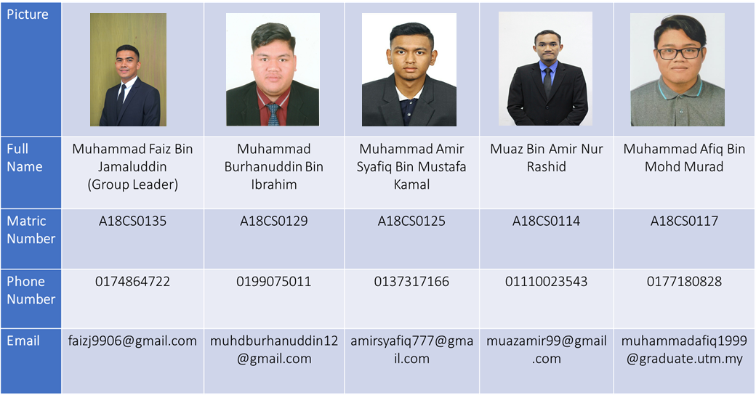
Group Members

